Slide 1
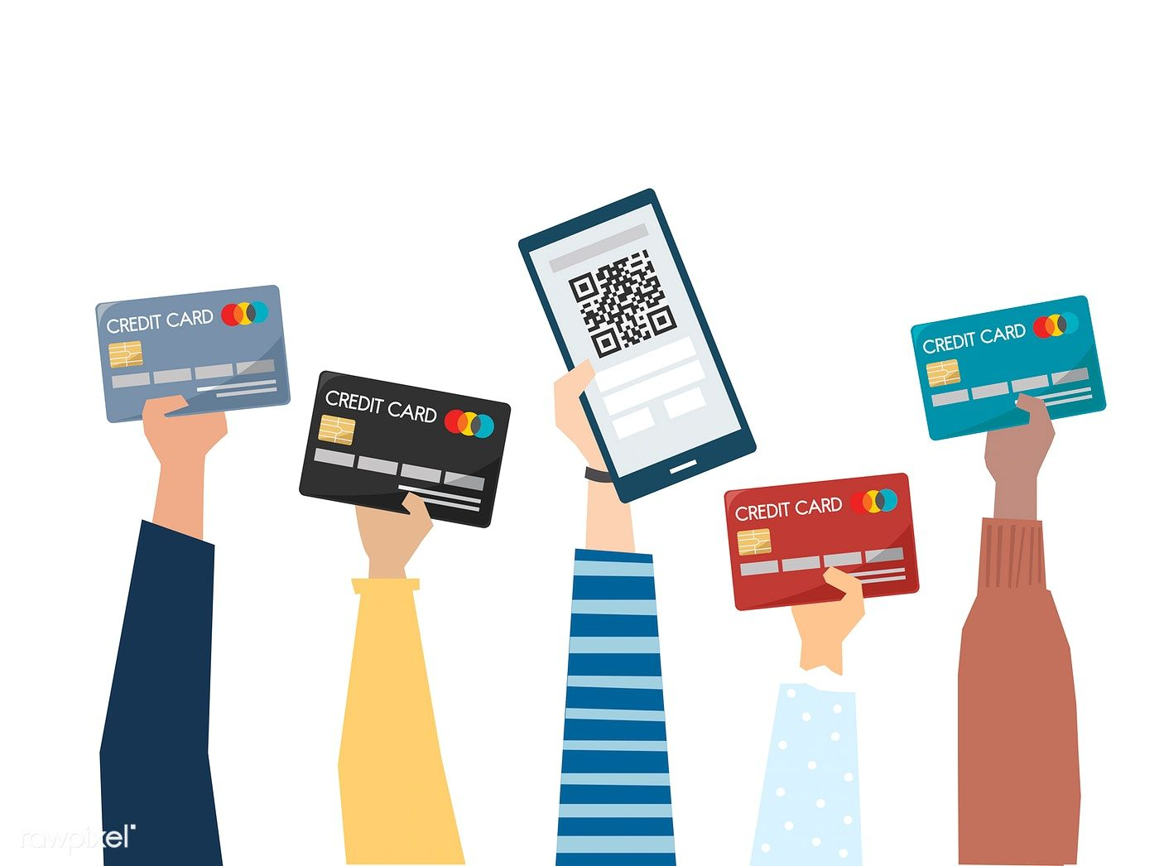
Training Inbound Payments
Date: 24.08.2022

Slide 2
Agenda
1. Payment Service Providers
Amway’s Payment Service Providers (PSPs)
How to get access to PSP‘s Backoffice
2. Worldpay
How to find a transaction
Payment and order details
Payment statuses
Where to look if transaction not appearing in transaction section
Refunds via Worldpay
Report: refusal reasons
3. Six Pay
Payment and order details (successful and failed)
Payment statuses
Refunds via Six Pay
4. PayPal
Payment statuses
Refunds via PayPal
5. Investigation on payment issues
Process of payment issue resolution
Required information for case resolution for Treasury
Required information for case resolution for PSP
Contact details and SLAs Worldpay
Contact details and SLAs Six Pay

Slide 3
Amway’s Payment Service Providers (PSPs)
How to get access to PSP‘s backoffice
1. Payment Service Providers

Slide 4
Amway’s Payment Service Providers (PSPs)
Worldpay
Six Pay
PayPal
Cooperation since 2018
Payment gateway and acquirer
Processing card transactions and alternative payment methods such Klarna, Trustly, Sofort, Bancontact, iDeal, P24
In Turkey cooperation with payment service provider Iyzico
Cooperation since 2010
Payment gateway and acquirer
Processing card transactions and PayPal
In Turkey cooperation with YapiKredi as acquirer
Cooperation since 2015
Transaction processed through Saferpay and settled through PayPal

Slide 5
PSP split by payment method
Notes:
Sofort in Austria disabled at the moment
PayPal in Baltic Countries to come by end of Q2
In Turkey Six Pay acts as payment gateway only. YapiKredi is acquiring bank.
Turkey will be switched to Worldpay / Iyzico once the problems are solved
France is with Six Pay due to problems with 3DS on Worldpay‘s side
Country | Credit / debit cards |  | Alternative Payment Methods
 |  |  | Six Pay | Worldpay
 | Worldpay | Six Pay | PayPal | GPay | Klarna Pay Now (Sofort) | Klarna | Trustly | P24 | Bancontact | iDeal | Carte Bancaire
Finland | x |  | x | x |  | x | x
Norway | x |  | x | x |  | x | x
Sweden | x |  | x | x |  | x | x
Denmark | x |  | x | x |  | x | x
Spain | x |  | x | x
Portugal | x |  | x | x
Netherlands | x |  | x | x |  |  |  |  |  | x
Belgium | x |  | x | x |  |  |  |  | x
Italy | x |  | x | x
Germany | x |  | x | x | x | x
Austria | x |  | x | x | x
France | x | x | x | x |  |  |  |  |  |  | x
Switzerland |  | x | x |  | x
UK |  | x | x |  |  |  | x
Ireland |  | x | x
Romania |  | x
Bulgaria |  | x
Hungary |  | x | x
Slovenia |  | x | x
Croatia |  | x
Czech |  | x | x
Slovakia |  | x | x
Poland |  | x | x |  |  |  |  | x
Estonia |  | x | x |  |  |  | x
Lithuania |  | x | x |  |  |  | x
Latvia |  | x | x |  |  |  | x
Greece |  | x | x
Turkey |  | x

Slide 6
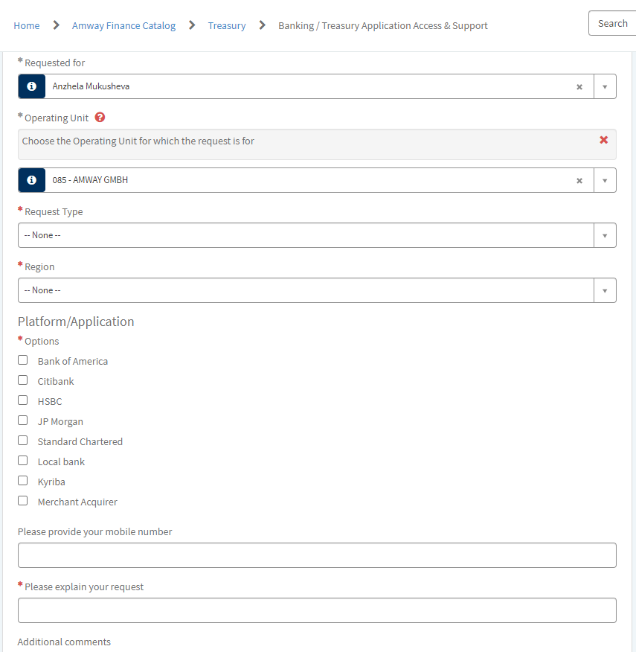
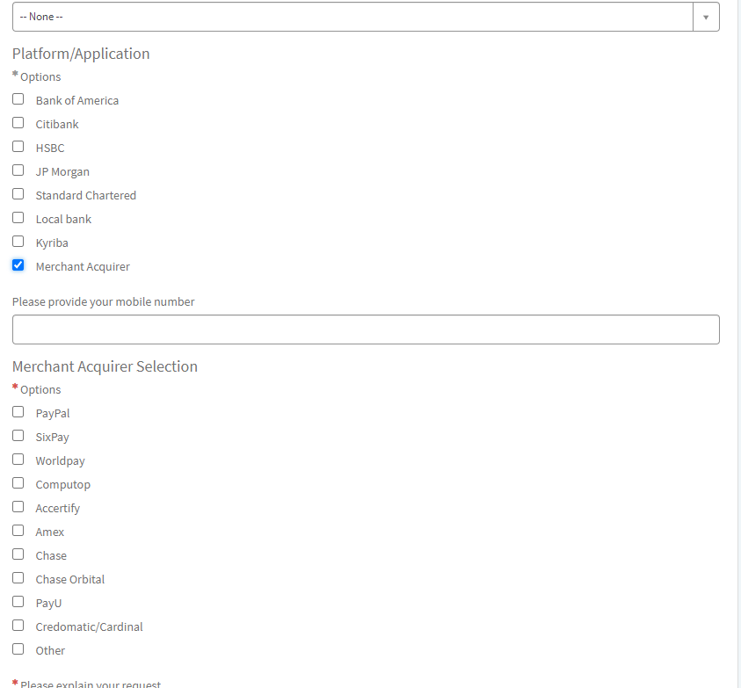
How to get access to PSP‘s back office
1. To get access to PSP‘s back office please use the link Banking / Treasury Application Access & Support
2. Fill out the form, tick the box “Merchant Acquirer”
3. Select payment service provider and submit the request
4. You will get the e-mail with the credentials once it’s available.

Slide 7
How to find a transaction
Payment and order details
Payment statuses
Where to look if transaction not appearing in transaction section
Refunds via Worldpay
Report: refusal reasons
2. Worldpay

Slide 8
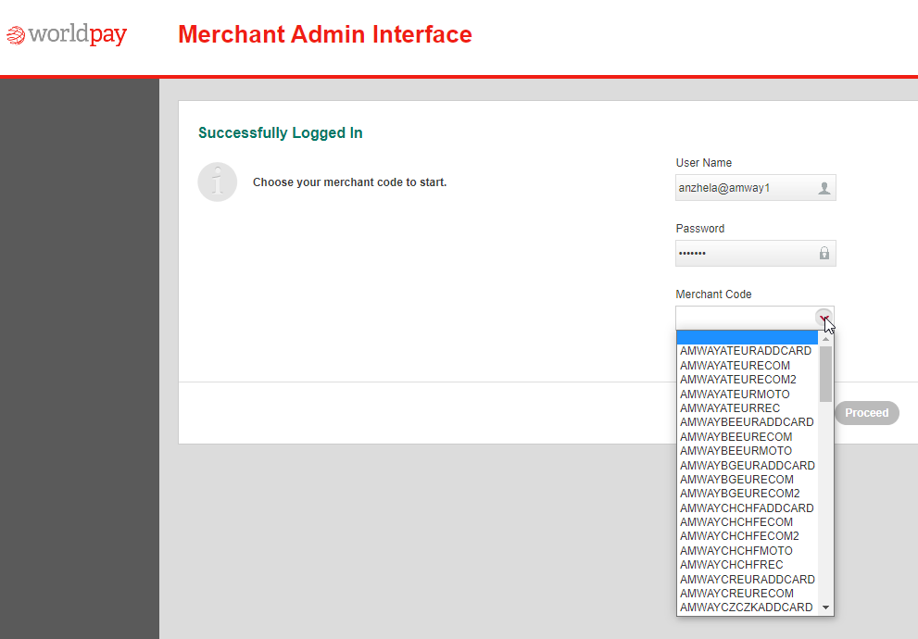
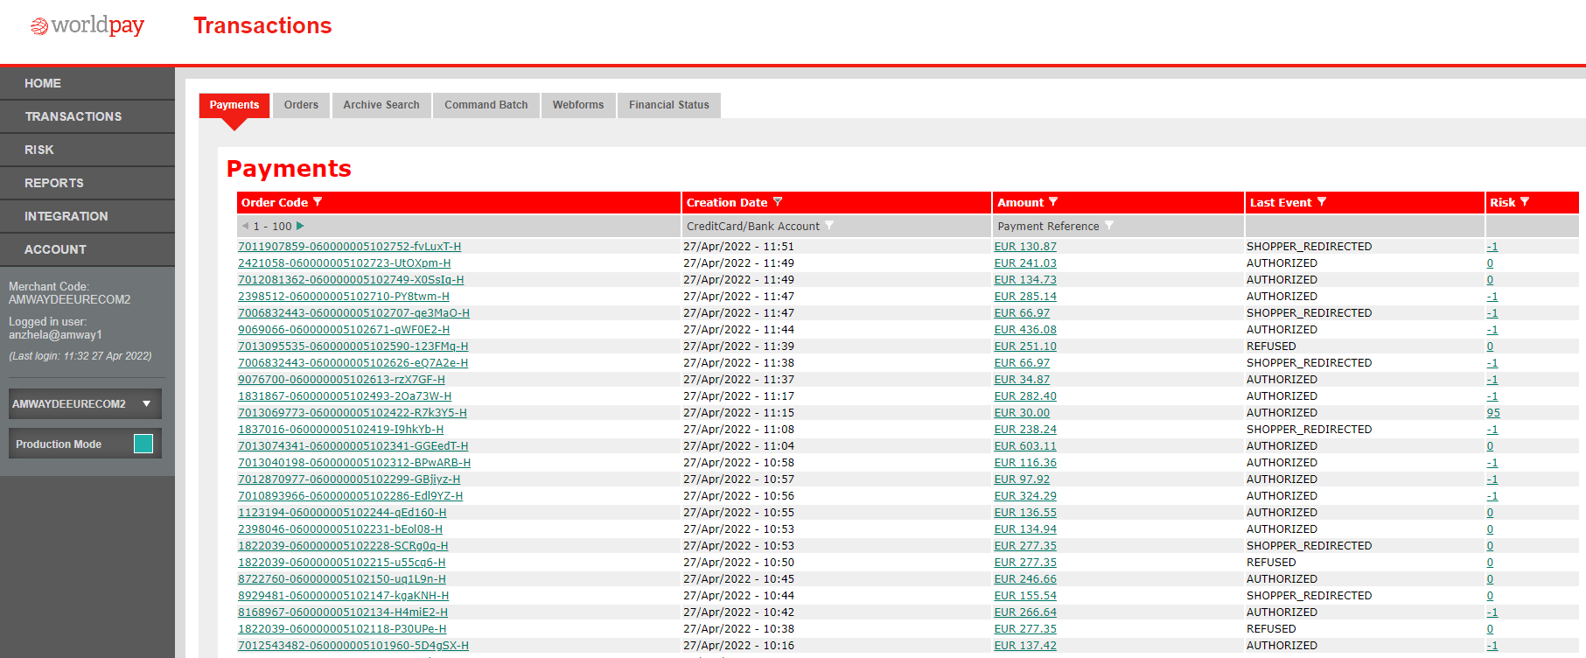





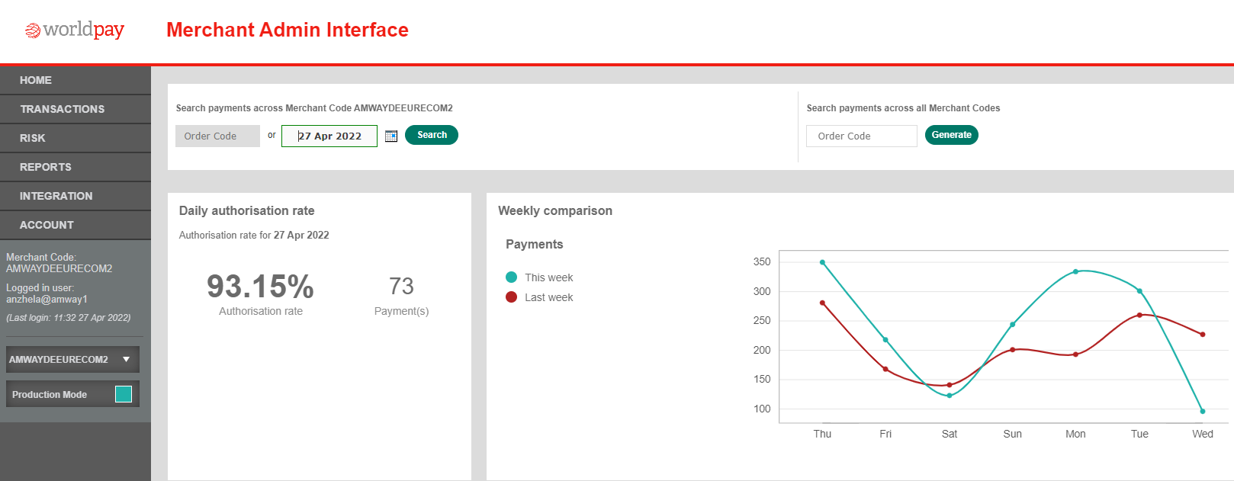
How to find a transaction
Login to Worldpay Merchant Admin Interface (MAI) and select a merchant code
How to find a transaction without having an order code:
Select merchant code
Go to transaction tab
Go to payments
Filter creation date (put the date when the order was created)
Filter the amount (put the amount of the order)
Put order code into left search field. This field is searching all transactions in the selected merchant code.
Put order code into right search field if you need to search across all merchant codes.

Slide 9
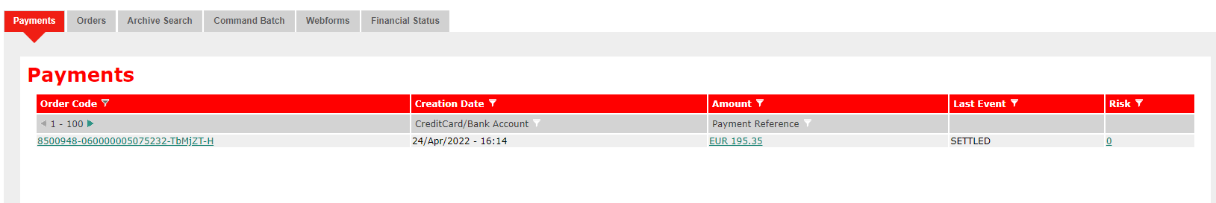
Payment & order details
Order code - this is unique reference number that is generated by Hybris for each payment attempt. Each Amway order can have several order codes. It depends on how many payment attempts the shopper needs in order to complete the payment.
Creation date – this is the date when payment transaction was processed.
Amount – this is the amount of the order that the shopper paid to Amway.
Last event – this shows the latest payment status of the transaction.
Risk – this shows the score that a transaction got after going through risk management tool. If the score is 100 and more the transaction is declined by risk management as fraud suspicious.
Click on the amount and you will get payment and order details for the transaction. Please refer to next slide.

Slide 10
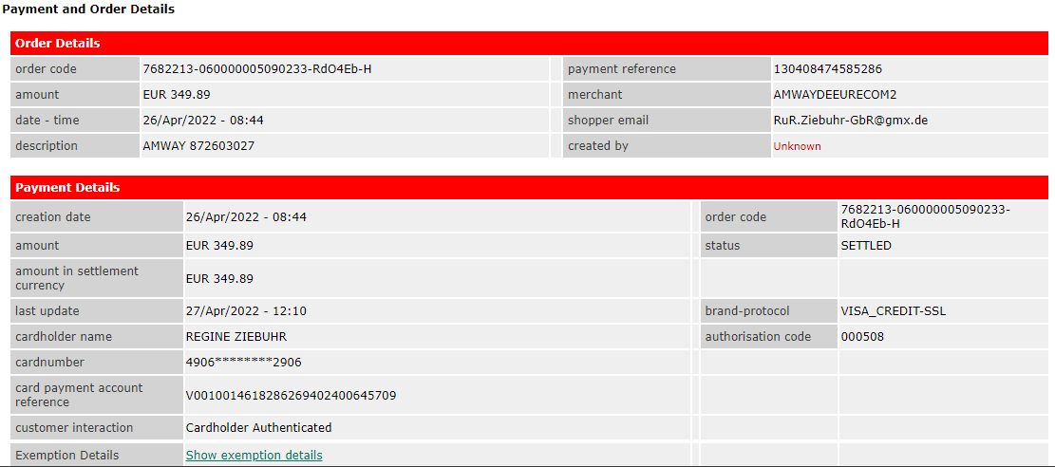




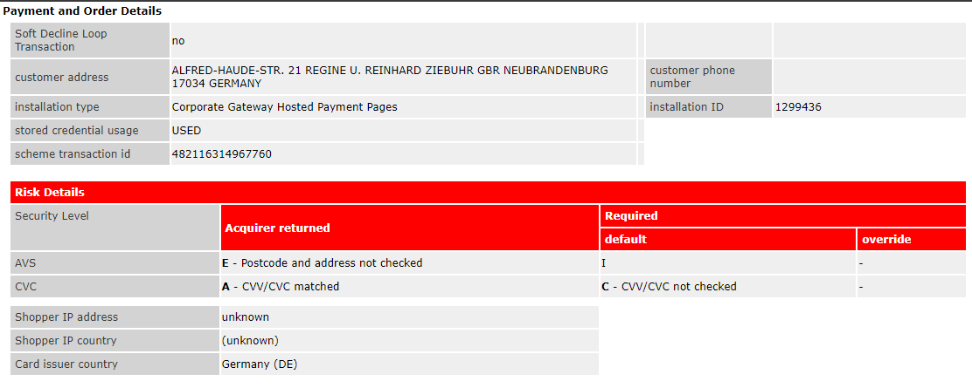
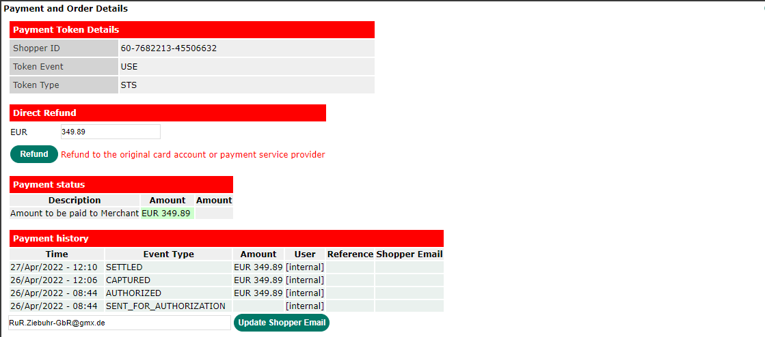

Payment & order details – useful information
Successful transaction
Order code
Merchant code
Shopper e-mail address
Order amount
Status of the transaction (if transaction is refused then status will be refused)
Payment method
Authorization code or refusal reason
Card number
3DS authentication status
Cardholder authenticated – 3DS authentication successful
Ecommerce – 3DS authentication failed
Authentication offered but not used - The relevant card issuer or cardholder is not enrolled
10. Payment history – shows all payment statuses for a particular transaction

Slide 11
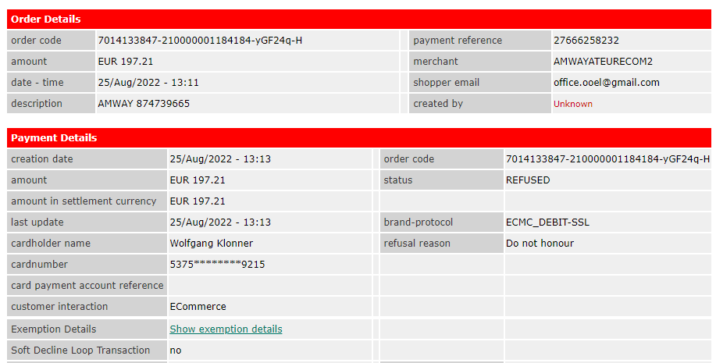
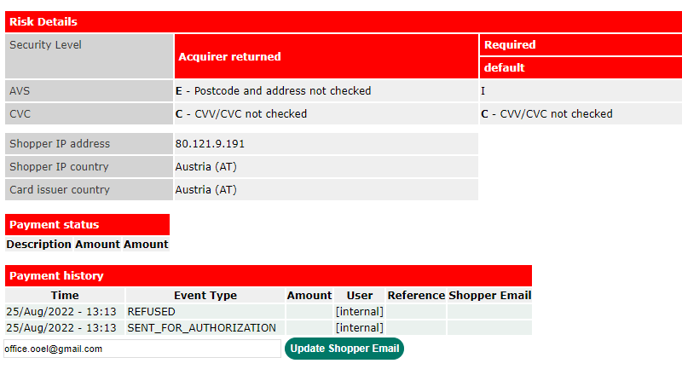
Payment & order details – useful information
Declined transaction
Order code
Merchant code
Shopper e-mail address
Order amount
Status of the transaction
Payment method
Refusal reason
Card number
3DS authentication status
Cardholder authenticated – 3DS authentication successful
Ecommerce – 3DS authentication failed
Authentication offered but not used - The relevant card issuer or cardholder is not enrolled
10. Payment history – shows all payment statuses for a particular transaction

Slide 12
Payment statuses
Payment status
Description
SENT_FOR_AUTHORISATION
We've requested permission (from the card issuer) to process the shopper's payment.
AUTHORISED
The payment has been approved and the funds reserved in the shopper's account.
CAPTURED
The funds reserved against the shopper's account have now been removed and are
travelling to your Worldpay account.
SETTLED
Funds have been received by Worldpay and are being prepared for transfer to your bank
account.
REFUSED
The payment request has been declined by a third party, or by a Worldpay fraud detection
service.
ERROR
The payment wasn't completed. Your shopper may want to reattempt it.
CANCELLED
Either Amway or a Worldpay fraud detection service have stopped the transaction.
EXPIRED
The authorization period ended before a capture or cancel request was made.
SENT_FOR_REFUND
You've requested funds to be sent back to the shopper. If online authorization is applicable,
this indicates that the refund was approved by the card issuer.
REFUND_FAILED
The refund couldn't be processed, and the funds were returned to your account. If online
authorization is applicable, this indicates that the refund was refused by the card issuer.
REFUNDED
A confirmation that the issuer will process the refund and the shopper will receive it.

Slide 13
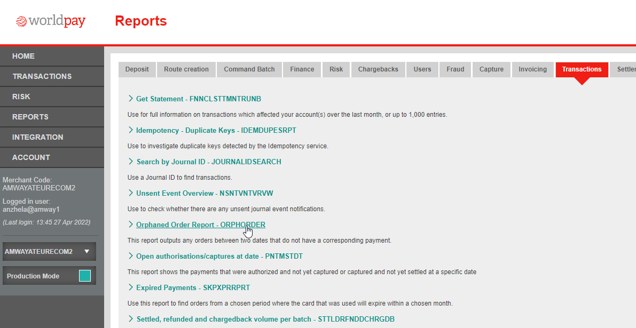
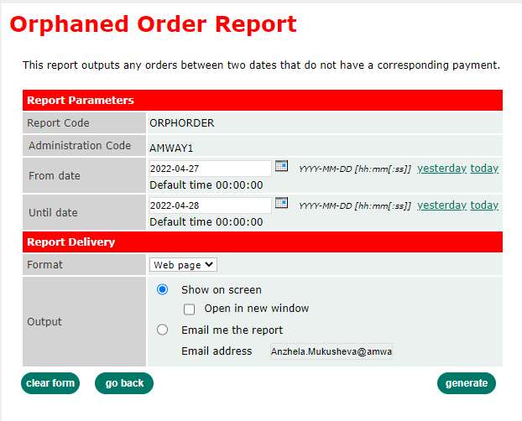
Where to look if transaction not appearing in transaction section
Go to reports
Go to transactions tab
Select “Orphaned Order Report – ORPHORDER“
Put the date when transaction was submitted
Put next day after transaction was submitted
Click on generate
Please note: this report can only be generated for 1 day.

Slide 14
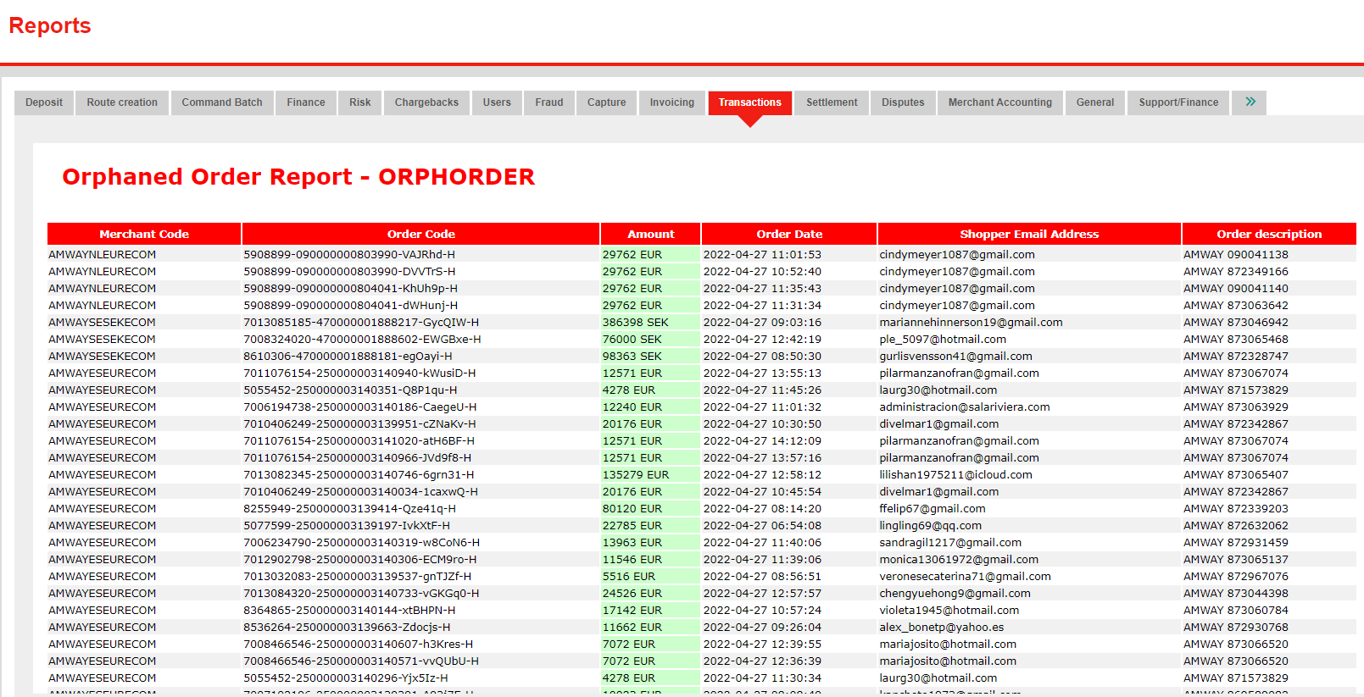
Where to look if transaction not appearing in transaction section
Worldpay generates the report with all orphaned orders for a particular day across all merchant codes.
The orders appearing in this report were not completed by the shoppers due to:
Closing the payment page before finishing the payment
Abandoning 3DS authentication challenge
Payment page having time-out session
Etc.
The report can’t be exported in Excel in automatic way. User can copy the table and paste into Excel.

Slide 15
Refund timings
Payment method | Refund Time
Cards | Up to 14 working days
Sofort | Up to 14 working days
Bancontact (formerly MisterCash) | Up to 14 working days
iDEAL | Up to 14 working days
Trustly | Up to 14 working days
Klarna | Up to 14 working days
P24 | Up to 14 working days

Slide 16



Refunds
Ghost order (payment is captured in Worldpay, but no order is created in Hybris)
Automated refund failed and needs to be initiated manually through Worldpay back office
Test transactions that appears during implementation projects
Please note:
Manual refund can only be initiated when transaction status is settled.
It can be initiated by Treasury or DE Team.

Slide 17
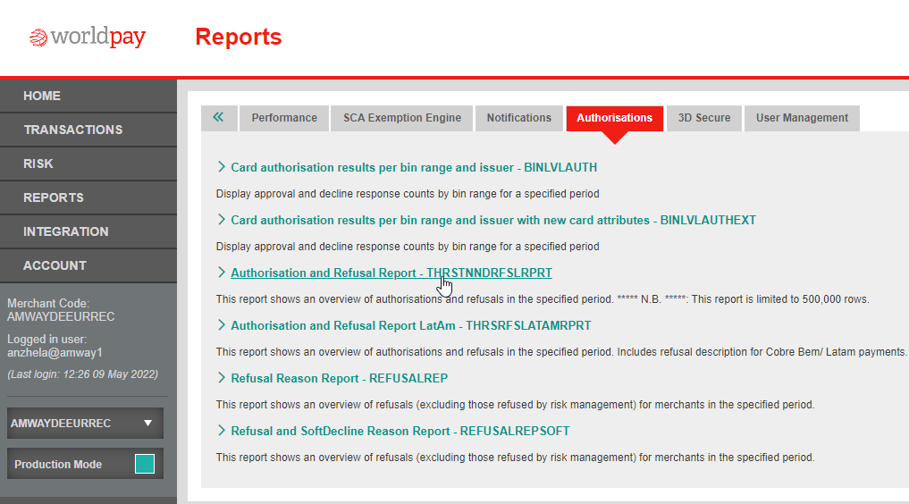
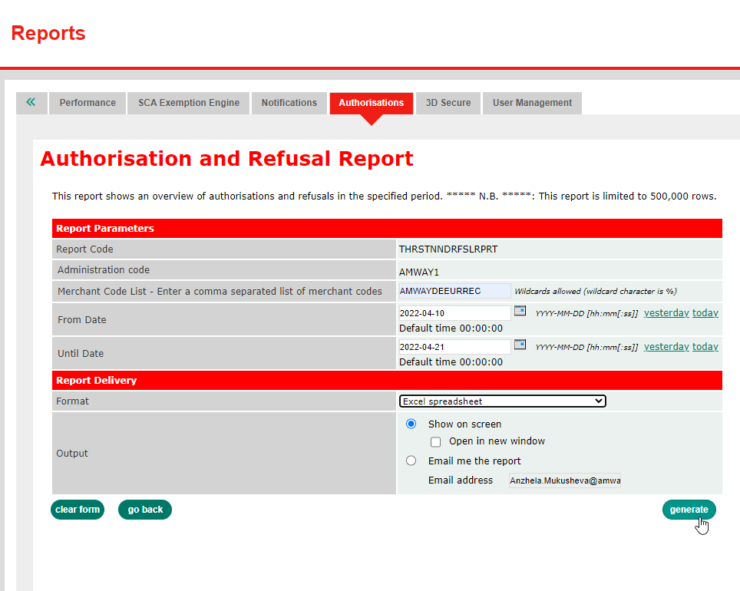
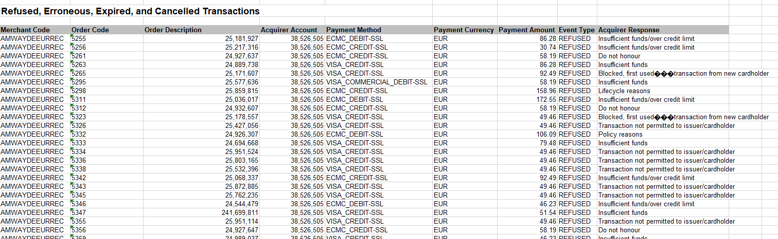
Report: refusal reasons
Login to Worldpay MAI and select a merchant code
Go to reports
Go to „Authorisations“ tab
Select “Authorisation and Refusal Report - THRSTNNDRFSLRPRT“
Put the merchant code you need the report for
Put from date
Put until date
Select „Excel spreadsheet“
Click on generate
If report isn‘t generated in step 9, then tick „Email me the report“, put your Email address and click on „generate“.
In the report you can see refusal reason in the “Acquirer Response” column.
Please note:
Transactions that couldn’t be processed to the bank won’t be shown in this report

Slide 18
Payment and order details
Payment statuses
Refunds via Sixpay
3. Six Pay

Slide 19
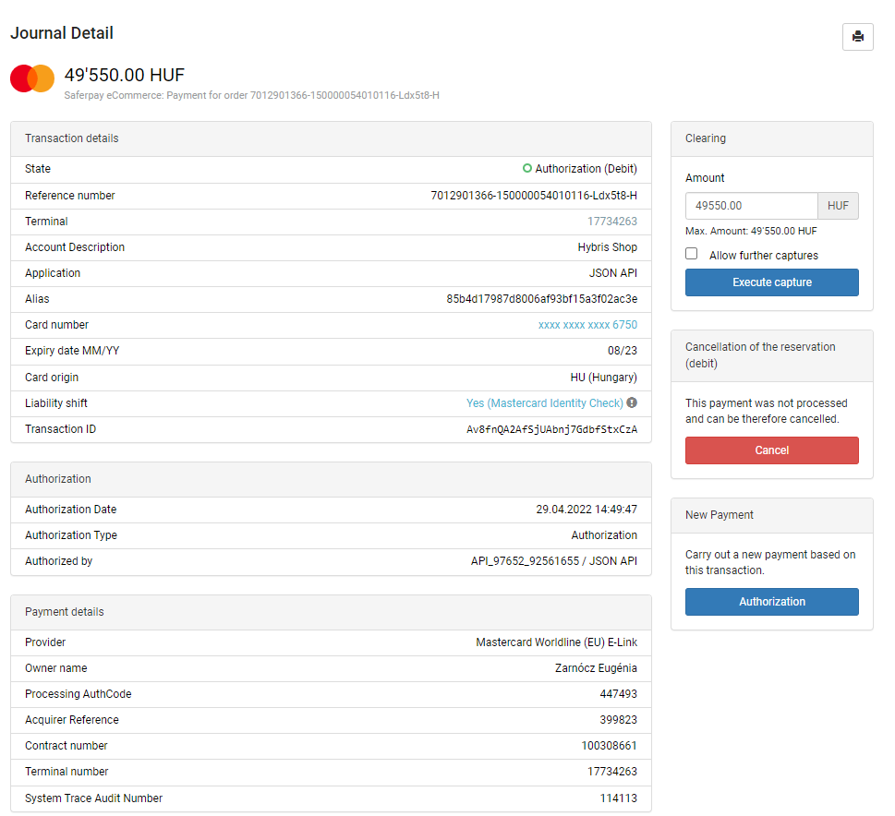
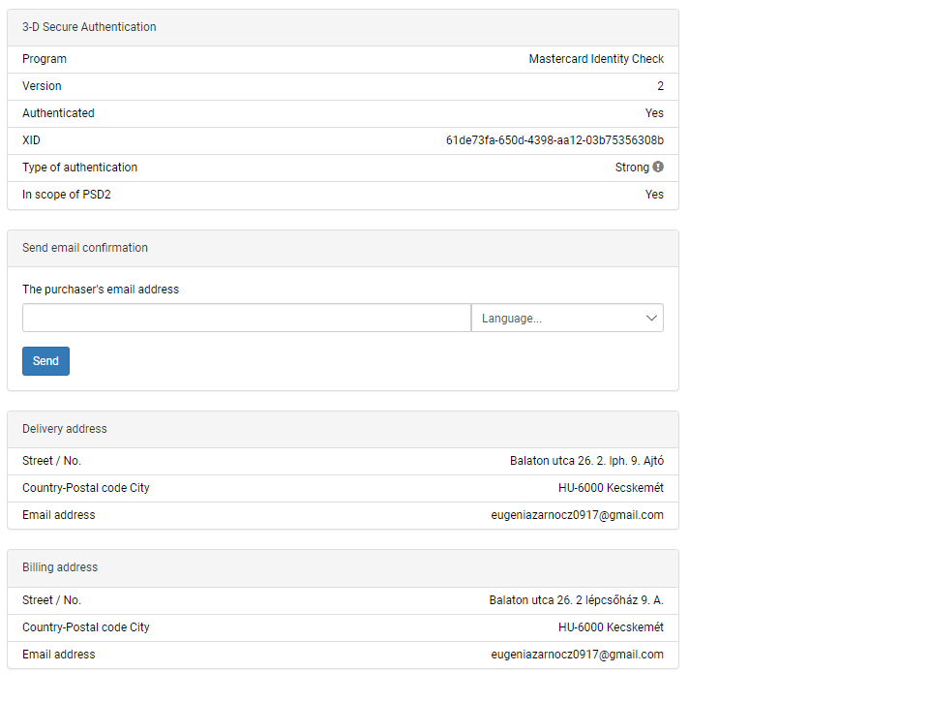
Payment & order details
Successful transaction:
Transaction status
Reference number
Terminal number
Card number
Payment method
3DS Authentication information
Shopper e-mail address
Order amount

Slide 20
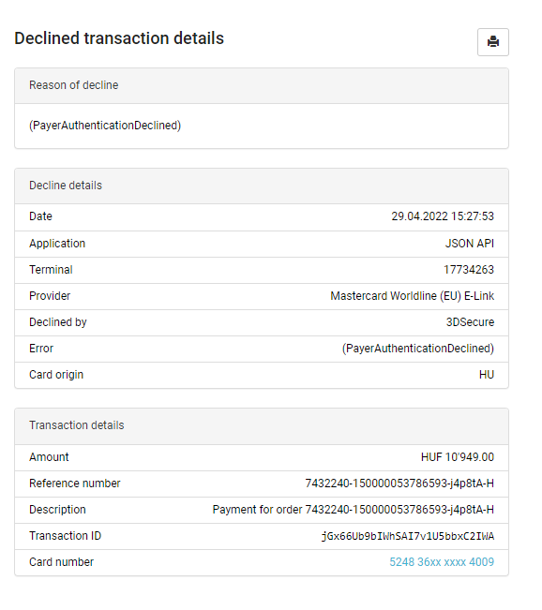
Payment & order details
Failed transaction:
Reason of decline
Transaction date
Terminal number
Payment method
Declined by
Transaction amount
Reference number
Card number

Slide 21
Payment statuses
Payment status
Description
Authorization (Debit)
The payment has been approved and the funds reserved in the shopper's account.
Cancellation (Debit)
The transaction was cancelled, and the funds were unblocked in the shopper's account.
Payment (Credit)
The funds reserved against the shopper's account have now been captured and settled to
Amway’s account.
Payment (Debit)
The funds were refunded to the shopper's account
Declined by acquirer
The payment request has been declined by a third party.
Declined by 3DSecure
The payment request has been declined by 3DSecure.

Slide 22
Refunds
Ghost order (payment is captured in Sixpay, but no order is created in Hybris)
Automated refund failed and needs to be initiated manually through Sixpay back office
Test transactions that appears during implementation projects
Please note:
Manual refund can only be initiated when transaction status is Payment (Credit).
It can be initiated by Treasury or DE Team.

Slide 23
Payment statuses
Refunds via PayPal
4. PayPal

Slide 24
Payment statuses
Payment status
Description
Pending
The order has been received by Amway, but payment has not yet been processed and is
waiting for
Authorisation
.
Completed
The transaction was
successful
and the money is in the Amway’s account
Reversed
Void of authorisation
–
trasaction unauthorised by buyer’s bank
Denied
If buyers have a problem with a transaction and open a dispute in PayPal’s Resolution
Centre.
Refunded/Partially refunded
Refund to the buyer for completed transaction (full or partial).

Slide 25
Refunds
Ghost order (payment is captured in PayPal/Sixpay, but no order is created in Hybris)
Automated refund failed and needs to be initiated manually through PayPal/Sixpay back office
Test transactions that appears during implementation projects
Please note:
Manual refund can only be initiated when transaction status is Completed/Payment (Credit).
It can be initiated by Treasury or DE Team.

Slide 26
PayPal transactions can be found also on Six Pay website.
Refunds can be processed by Six Pay as well.
To find PayPal transacion in Six Pay or process refund please check slides regarding how to find a transaction in Six Pay.

Slide 27
Process of payment issue resolution
Required information for case resolution for Treasury
Required information for case resolution for PSP
Contact details and SLAs Worldpay
Contact details and SLAs Six Pay
5. Investigation of payment issues

Slide 28
Process of payment issue resolution
Check transaction in Worldpay MAI
No success
Check with Treasury on Teams Group Chat
No success
Treasury contacts PSP for investigation
PSP
Wolrdpay
Success
Success
Success
Case resolved
Contact rules
Check with Treasury on Teams Group Chat
No success
Treasury contacts PSP for investigation
PSP
Treasury Team on Teams | Monday - Friday 8.30am – 5pm
PSP directly when major incident according to SLA classification | Outside of working hours, on the weekends and when Anzhela & Joanna both are out of office
SixPay / PayPal
Success
Success
Case resolved

Slide 29






Required information for case resolution for Treasury
Country
Payment method
Order code
Example:
Credit card, PayPal, etc.
Example:
7011975238-060000004185550-Pf70ob-H
Refund: for Worldpay original order code
for Six Pay such reference 34095699017-96659003
Example:
Italy, Germany, etc.
Clear problem description
Proof of payment in case of „ghost“ order for APMs
Additional information
Example:
ABO makes a payment via P24 and doesn’t come back to Amway’s website.
Order is not created, but payment is taken.
Example:
Customer is trying to place order, but transaction failed. Please find below details for customer: Country - Italy date of transaction - 18th Aug MOP - Credit card payment provider - lynxita_worldpay_config Transaction id : 2632644-160000009557698-L9k3Uo-H
Could you please check why it has failed?
In case you do not have an order code please provide:
ABO / customer number
Date of the transaction
Amount of transaction
Notes:
Orders scenarios
Return scenarios
> L2 team start checking WP panel
> No success, check with Anzhela and Joanna on teams group channel then
> Anzhela/Joanna will send email to WP or SixPay
Also, what minimum information is required to be shared to the treasury team/payment provider. We can even come up with a template to be filled for each case and a proper subject line.

Slide 30

Required information for case resolution for PSP
Merchant code or terminal number
Order code
Example:
Worldpay - AMWAYATEURECOM2
Six Pay - 17726065
Example:
Regular order: 7011975238-060000004185550-Pf70ob-H
Refund: for Worldpay original order code
for Six Pay such reference 34095699017-96659003
Clear problem description
Proof of payment in case of „ghost“ order for APMs
Example:
We’ve received information from ABO that she hasn’t receive refund for her return, which was processed via WorldPay on 6^{h} June 2022.
Merchant code: AMWAYITEURECOMHYB
Transaction code: 7012449880-160000007289036-il4ax3-H
Could you please provide ARN number?
Example:
ABO makes a payment via P24 and doesn’t come back to Amway’s website.
Order is not created, but payment is taken.
Notes:
Orders scenarios
Return scenarios
> L2 team start checking WP panel
> No success, check with Anzhela and Joanna on teams group channel then
> Anzhela/Joanna will send email to WP or SixPay
Also, what minimum information is required to be shared to the treasury team/payment provider. We can even come up with a template to be filled for each case and a proper subject line.

Slide 31
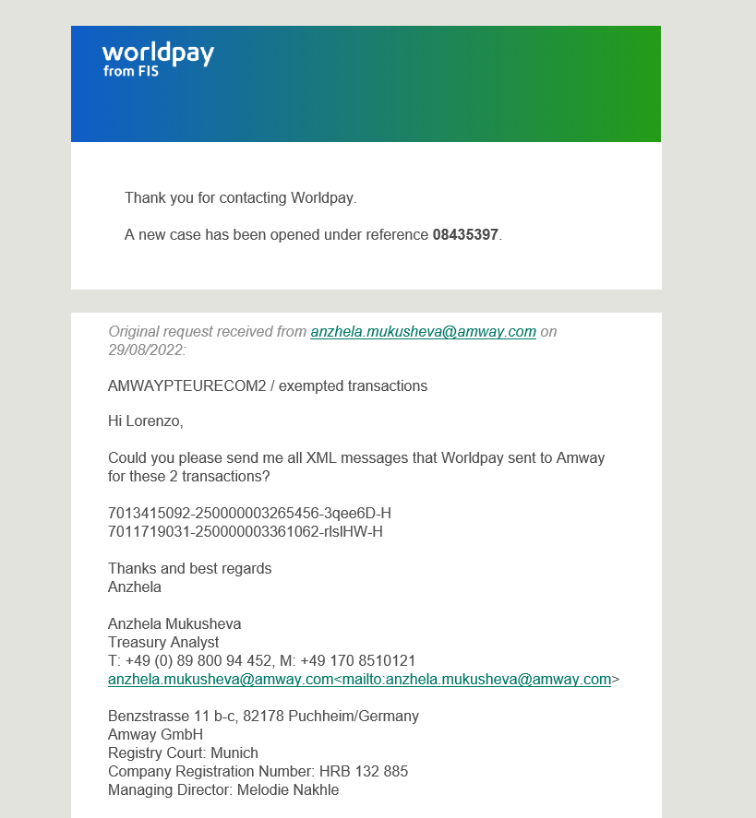
Contact details Worldpay
Time | Name | Role | Phone | Email | When to contact
09:00-17:00 CET Mon-Fri | Lorenzo Mandara | Client Success Manager | +31 6 12 71 86 20 | support.lorenzo.mandara@worldpay.com | All operational issues with payments when Anzhela and Joanna are out of office
24/7/365 | Emergency Out of Hours Support | Dedicated Ecommerce Technical Support | Call: +31 20 799 4777 | support.lorenzo.mandara@worldpay.com Send e-mail with the request first Call by phone and quote sales force number case which you get (example below) | To use on the weekends and out of working hours if any urgent issues.
(Outside of 9-5 GMT Mon-Fri) 24/7/365 | Major Incident | Dedicated ECOM Tech Support (Major Incident only) | Global Technology Service Centre | support.lorenzo.mandara@worldpay.com Send e-mail with the request first Call by phone and quote sales force number case which you get | To use on the weekends and out of working hours if any urgent issues
 |  |  | Call: +44 208 712 5708 / option 2
When you send an e-mail to Worldpay you get an automated response with sales force case number

Slide 32
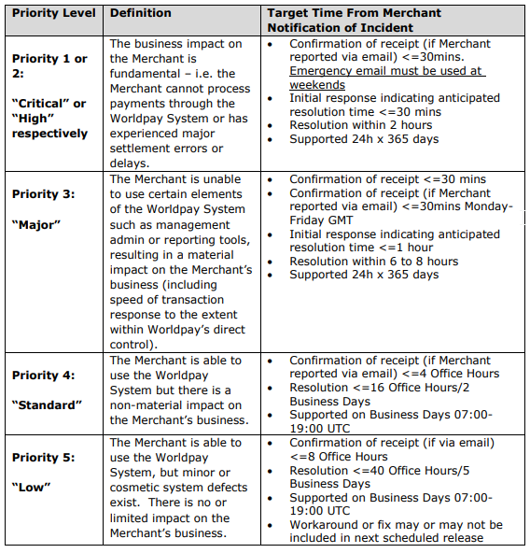
SLAs Worldpay

Slide 33
Contact details Six Pay

Slide 34
SLAs Six Pay
Level | Impact Criteria* | Impact
Level 1 | 50 – 100 % of all Transactions affected | Extensive/High
Level 2 | 20 - 50 % of all Transactions affected | Significant/Medium-High
Level 3 | 5 – 20 % of all Transactions affected | Moderate/Medium
Level | Reaction Time | Ø Resolution time | Response Time | Committed Resolution Time | Impact
Level 1 | 20 (40) Min. | less than 2 hours | 30 Min. | Within 4 hours | Extensive/High
Level 2 | 20 (40) Min. | less than 4 hours | 30 Min. | Within 8 hours | Significant/ Medium-High
Level 3 | 20 (40) Min. | Less than 8 hours | 60 Min. | Within 1 week | Moderate/ Medium

